Slide 1



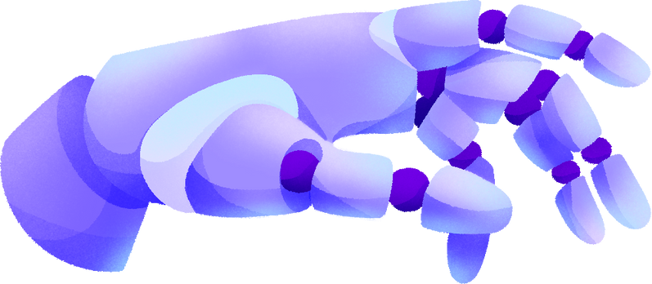

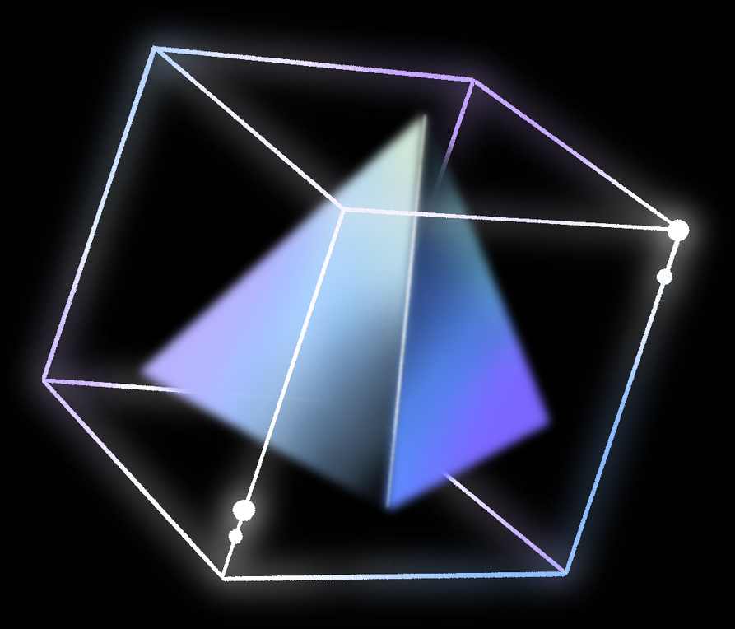
DELE CA2 PART B
Reinforcement Learning
By Shen lei and Xavier

Slide 2
TABLE OF CONTENTS
Context
Background research
EDA
Base Models
Model Improvements
Hyperparameter tuning
evaluation
conclusion and best model

Slide 3

CONTEXT
Reinforcement learning is an AI method where agents learn optimal actions through trial, error, and rewards.
What is this project about?
This project trains a reinforcement learning agent to balance an inverted pendulum in OpenAI Gym’s Pendulum-v0 environment. Starting from a downward position, the agent learns to apply torque to swing it upright and keep it stable, mimicking control challenges in robotics and self-balancing systems through reward-based interaction.

Slide 4
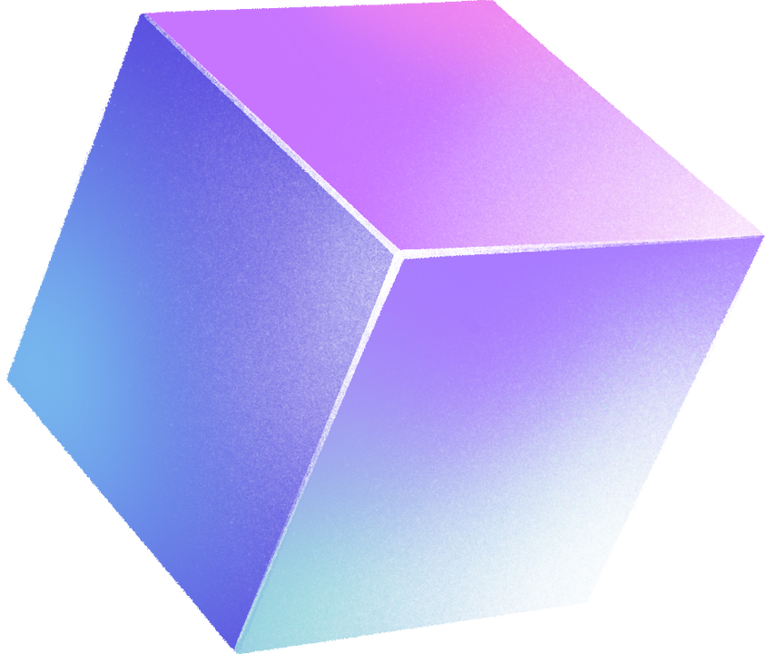

BACKGROUND RESEARCH
Part 1 – Task & Observations
Objective: Swing and balance an inverted pendulum upright on a frictionless joint.
Environment: Simulates a pendulum on a frictionless pivot.
Observation Space: Continuous 3D vector [cos(θ), sin(θ), θ̇] describing angle and angular velocity.
Value Range: Observation components ∈ [-8.0, 8.0].
Part 2 – Actions, Rewards & Challenges
Action Space: Single continuous torque value in [-2.0, 2.0] (shape (1,)).
Reward Function: Penalizes deviation from upright, excessive angular speed, and high torque use.
Challenges: Continuous action space, requires swing-up then balance control, sensitive to exploration and tuning.

Slide 5

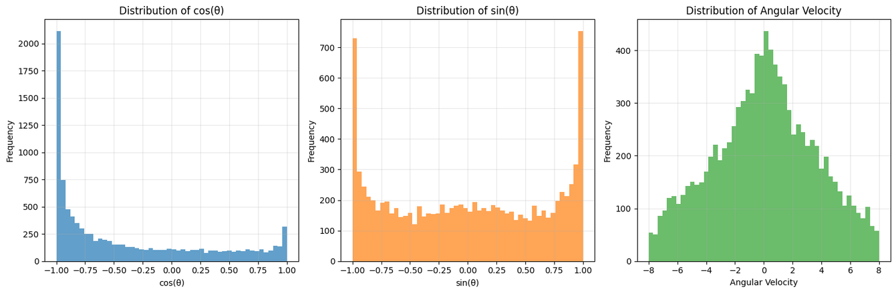
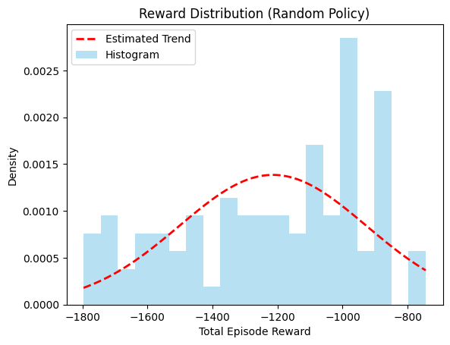
02
01
The pendulum’s cos(θ) and sin(θ) distributions peak near -1 and 1, showing it frequently reaches upright and inverted positions, with less time in intermediate angles. Angular velocity follows a symmetric bell curve centered at zero, indicating mostly moderate speeds and fewer extreme velocities. This reflects natural pendulum motion — rapid acceleration in mid-swing and deceleration at turning points. Overall, the pendulum often lingers at extreme angles with moderate angular velocities, consistent with expected physical behavior in the Pendulum environment.
Most rewards range from -1400 to -900, peaking near -1050. Distribution is uneven, loosely bell-shaped, and entirely negative, reflecting inconsistent, unoptimized performance typical of a random policy in Pendulum.

Slide 6
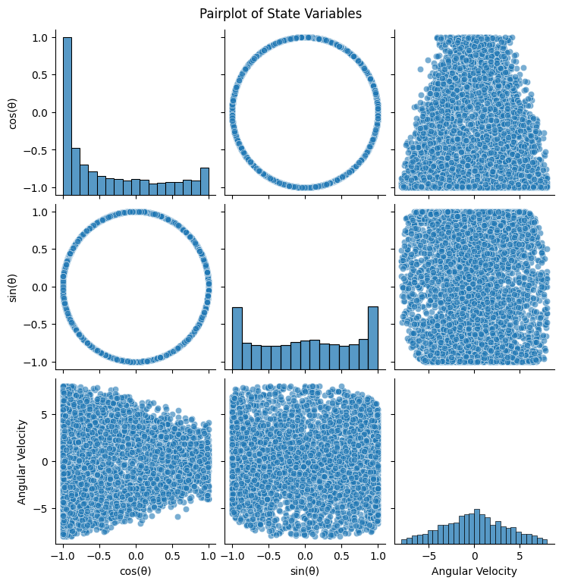
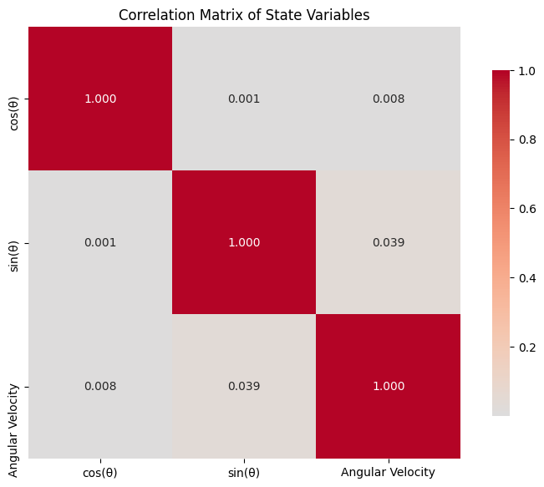
03
04
The pairplot shows cos(θ) and sin(θ) forming a circle, confirming their trigonometric link. Peaks near -1 and 1 indicate extreme angles, while angular velocity is widely distributed under random actions.
The pairplot shows cos(θ) and sin(θ) forming a circle, confirming their trigonometric link. Peaks near -1 and 1 indicate extreme angles, while angular velocity is widely distributed under random actions.

Slide 7
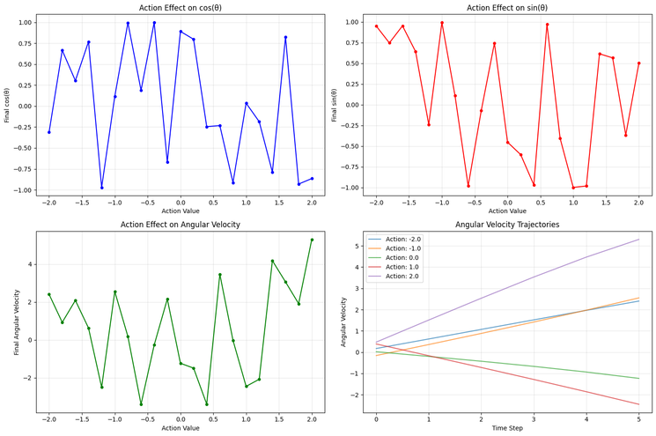
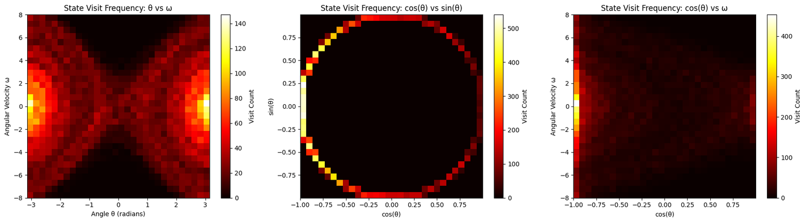
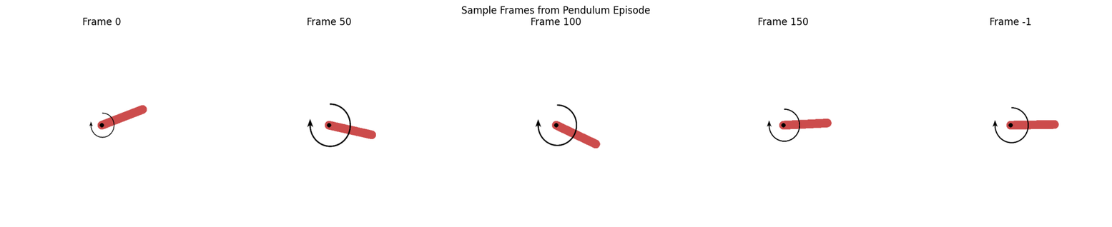
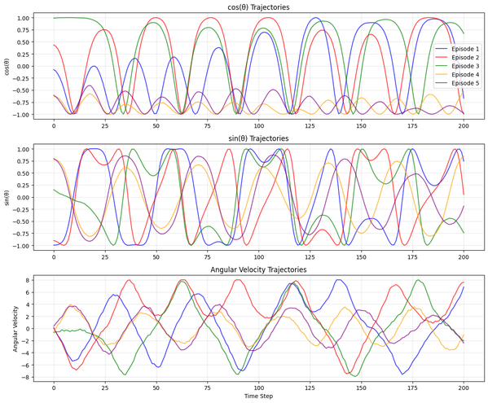
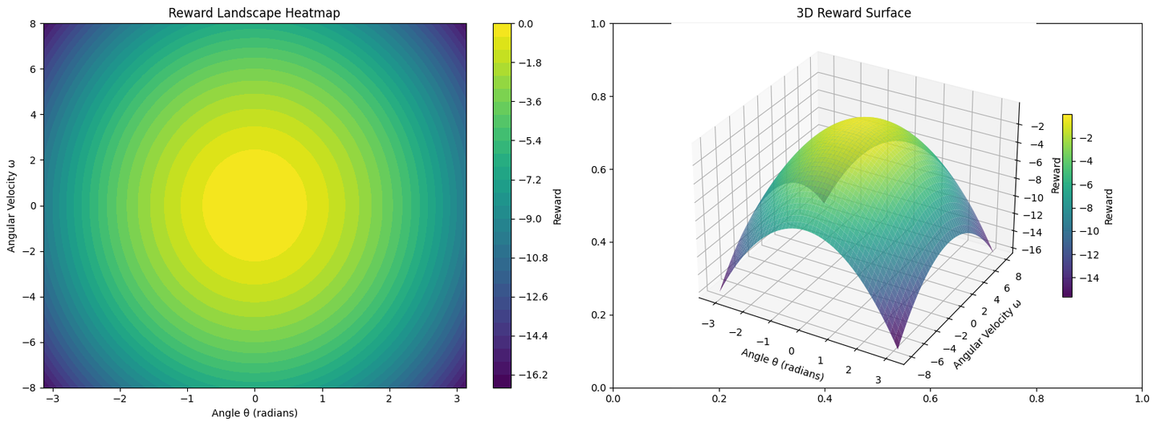
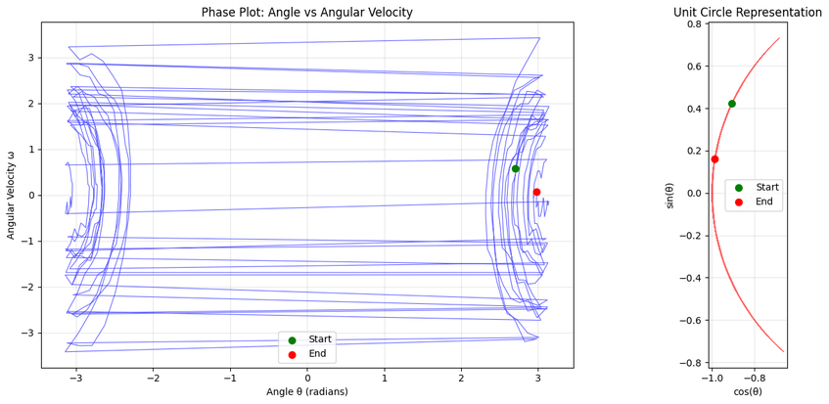
More eda

Slide 8

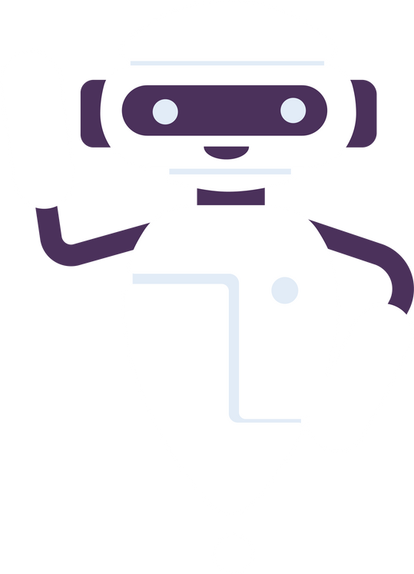





BASE MODELS TO EXPERIMENT
SOFT ACTOR-CRITIC (SAC)
NORMAL DQN
NOISY DQN
Learns action-value function Q(s,a)Q(s,a)Q(s,a) using a neural network.
Features: Experience replay, target network, ε-greedy policy.
Pros: Simple, effective for discrete actions.
Cons: Overestimation bias, instability possible.
Adds trainable noise to weights for adaptive exploration.
Features: Noisy layers, removes ε-greedy tuning, state-dependent exploration.
Pros: Efficient, consistent exploration.
Cons: Slightly higher training complexity.
Maximizes both return and entropy for balanced exploration/exploitation.
Features: Separate actor/critic networks, temperature parameter, continuous action support.
Pros: Stable, sample-efficient, effective in continuous spaces.
Cons: Higher computation cost.

Slide 9

Why These 3 Models
Normal DQN – Baseline Value-Based Method
Serves as the reference point for performance.
Widely used and well-understood in RL literature.
Good to see how a standard discrete-action method handles the task after discretization.
Noisy DQN – Exploration-Enhanced Value-Based Method
Builds directly on DQN to address exploration weaknesses.
Lets you isolate the impact of exploration strategy while keeping the architecture similar to the baseline.
Good for testing if better exploration improves stability and returns.
Soft Actor-Critic (SAC) – State-of-the-Art Actor-Critic Method
Designed for continuous action spaces, avoiding discretization entirely.
Tests how a policy-gradient-based approach compares to value-based methods.
Incorporates entropy maximization, which may yield better exploration and stability.

Slide 10

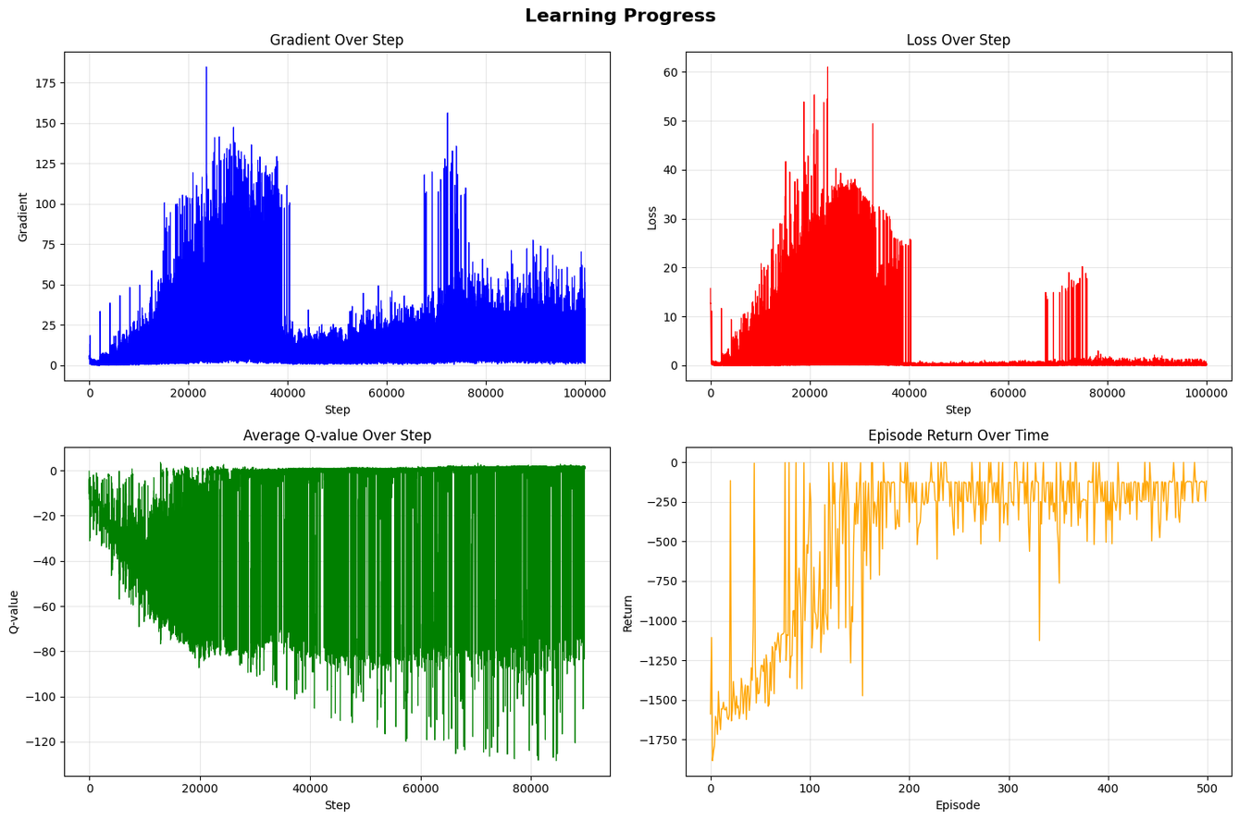
NORMAL DQN
Strengths:
Fast convergence to high-reward policy.
Strong early learning signals.
Improved Q-value accuracy over time.
Consistent high returns once converged.
Weaknesses:
Late-stage gradient spikes.
Fluctuating Q-values even after convergence.
Sudden loss spikes indicating sensitivity to certain states.
Occasional large drops in episode returns.

Slide 11
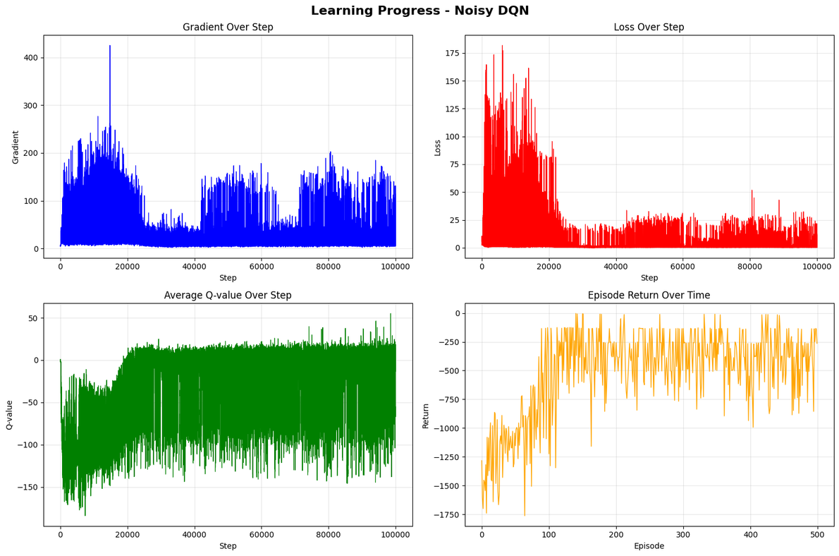
NOISY DQN
Strengths:
Fast learning with rapid early performance gains.
Effective exploration from parameter noise.
Improved Q-value accuracy over time.
Sustains high average returns after convergence.
Weaknesses:
Frequent late-stage gradient spikes.
Persistent Q-value fluctuations after convergence.
Episodic return drops despite strong averages.
Instability in value estimation during noisy exploration.

Slide 12
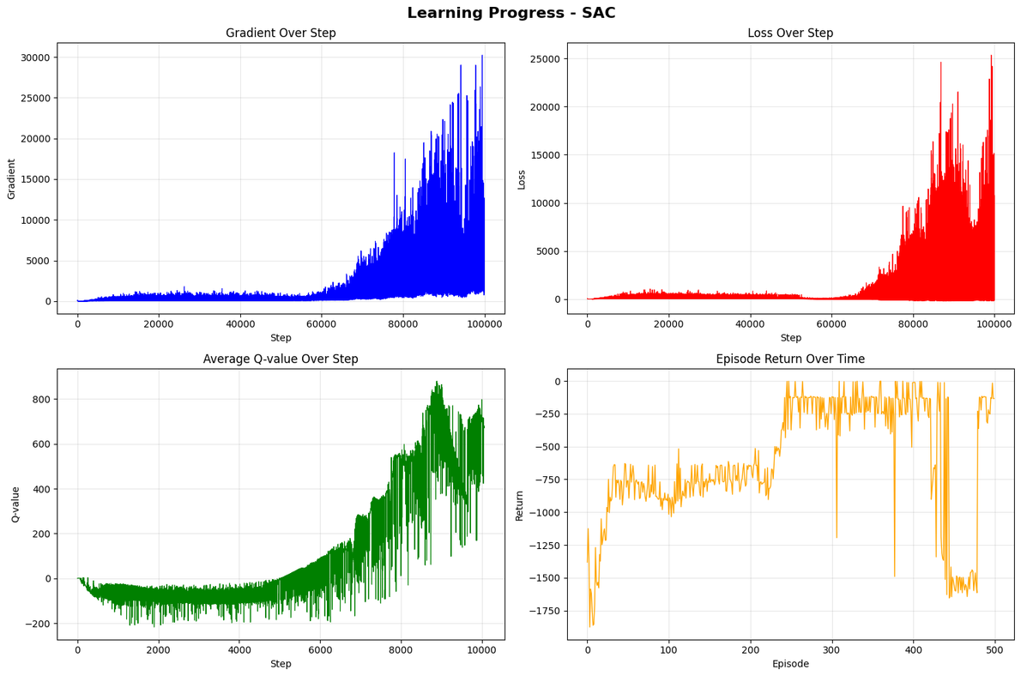
Strengths:
Smooth, controlled gradient growth during early-to-mid training.
Stable low loss for first 60k steps.
Steady Q-value improvement from negative to high positive.
Rapid early episode return gains and sustained good performance.
Final near-zero returns indicate excellent pendulum control before collapse.
Weaknesses:
Post-60k step gradient and loss explosions indicate training breakdown.
No self-recovery once instability begins.
Persistent Q-value volatility despite upward trend.
Final episode performance collapse tied to instability.
SAC

Slide 13
conclusion from baseline
Normal DQN
High performance in terms of returns.
Unstable — frequent Q-value fluctuations and episodic return drops.
Noisy DQN
More stable training process.
Decent performance with effective exploration from parameter noise.
SAC
Most stable learning curve.
Underperforms in returns compared to DQN-based models.

Slide 14
MODEL IMPROVEMENTS I DID FOR EACH
SOFT ACTOR-CRITIC (SAC)
NORMAL DQN
NOISY DQN
True noisy Dqn
Auto Entropy SAC
Normalized SAC
DoubleDqn
Dueling Dqn
Prioritised Dqn
Reward Normalized Dqn

Slide 15
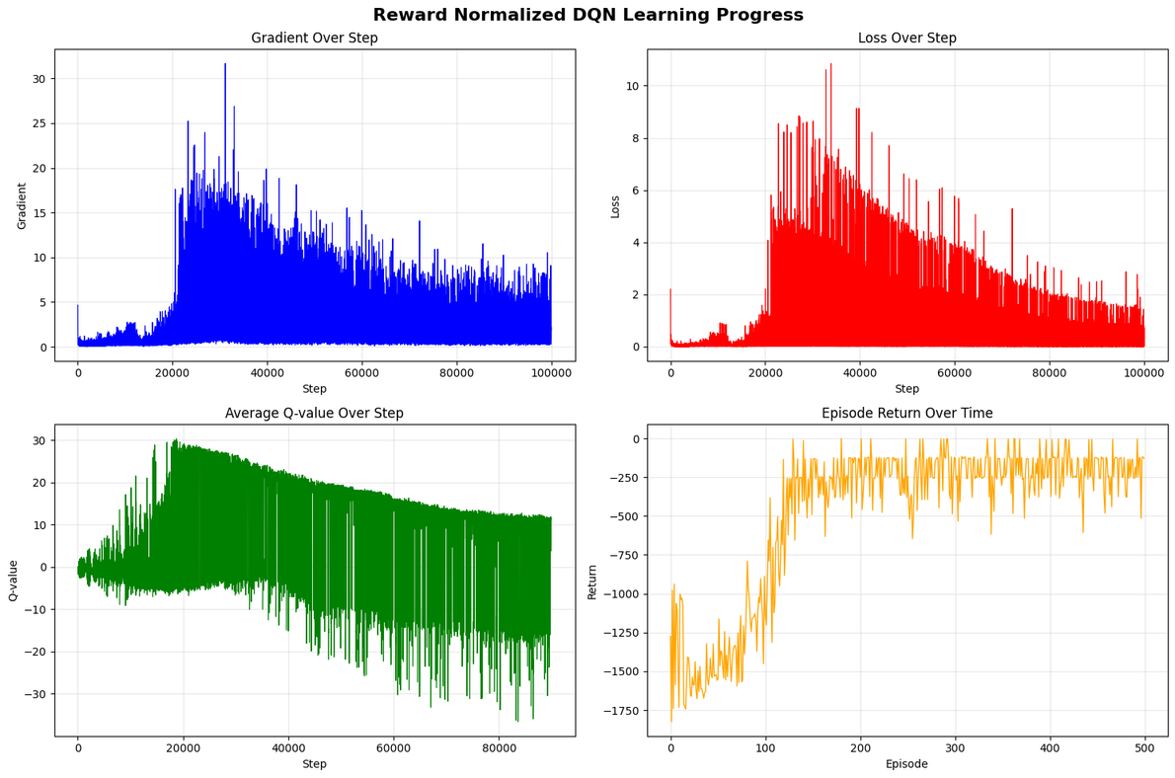
BEST IMPROVEMENT AND HYPERPARAMETER TUNING
Observation:
Normalised DQN improved stability over Normal DQN but slightly reduced average episode returns.
Decision:
Trial Normal DQN (high returns, unstable).
Trial Normalised DQN (stable, slightly lower returns).
Goal:
Use hyperparameter tuning(random search) to balance performance and stability.

Slide 16
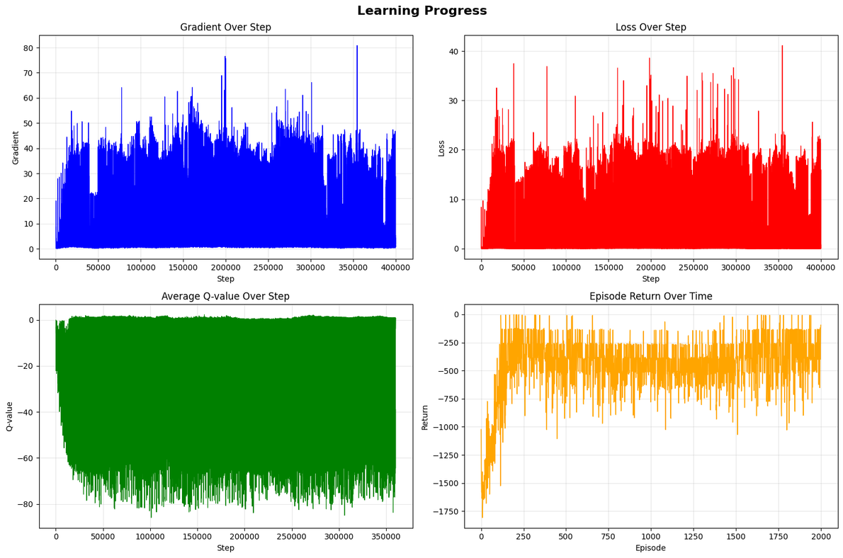
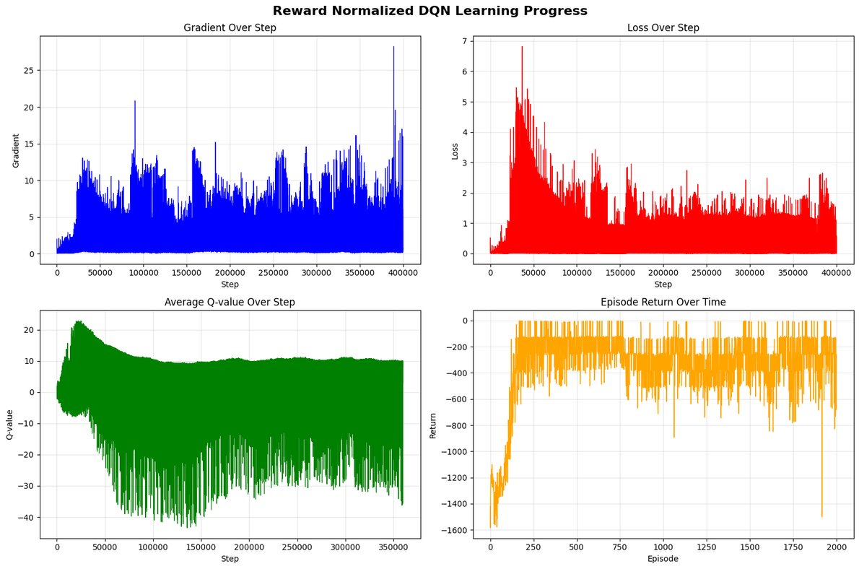
Evaluation
Base dqn optimized
Normalized dqn optimized

Slide 17
Choosing Between Normal DQN & Normalized DQN
Normal DQN:
Became more stable after changes.
Issue: Loss remained high → results compromised for stability.
Normalised DQN:
Stable training with lower loss.
Performance not significantly affected.
Conclusion:
Normalised DQN wins — better stability + low loss without sacrificing results.

Slide 18


Model Performence

Slide 19
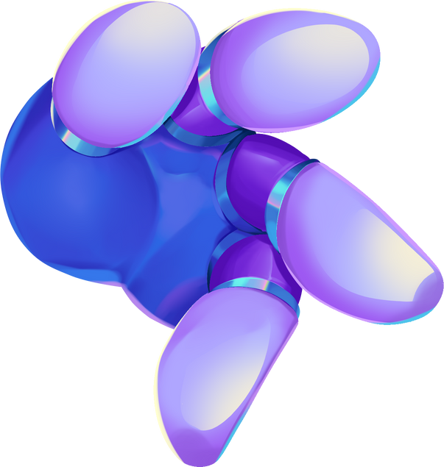
THANK YOU!

